Slide 1
Predictive Probability of Success (PoS)
Virtual ICB case study: Using PFS to predict OS (log(HR), p<0.05) Jinjie Chen

Slide 2
Background: why PoS (not only power)
In drug development, a Go/No-Go decision often depends on the chance that a future confirmatory analysis will meet a pre-specified success criterion.
Classical power assumes the true treatment effect is fixed and known (or set to a design alternative). In practice, the true effect is uncertain and should be updated by accumulating evidence (historical trials, interim data, surrogate endpoints, etc.).
Predictive Probability of Success (PoS) answers:
“Given what we know today, what is the probability the current (future) study will be declared successful?”
Notes:
Put speaker notes here. Keep them short.

Slide 3

Core objects and notation
Let $Y^{∗}$ denote the test statistic or effect estimate from the future (or not-yet-mature) analysis; let $R$ be the success region defined by the protocol.
Examples of $R$:
- Frequentist: $p<0.05$ (two-sided) and effect in the favorable direction - Bayesian: $Pr\left(θ<0∣\text{data}\right)>0.95$
- Clinical: lower CI bound exceeds a clinically meaningful threshold
Assume the primary endpoint is overall survival (OS) and the analysis is based on the log(HR).
True treatment effect (parameter)
$$θ≡θ_{OS}=log\left(HR_{OS}\right)$$
This is the latent (unobserved) “true” log(HR) in the target population.

Slide 4
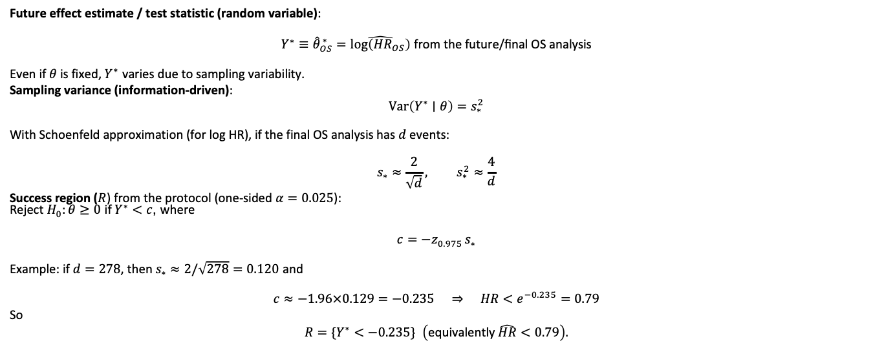
Core objects and notation - continued
Future effect estimate / test statistic (random variable):
$$Y^{∗}≡{\hat{θ}}_{OS}^{ ∗}=\hat{log\left(HR_{OS}\right)} \text{from} \text{the} \text{future}\text{/}\text{final} \text{OS} \text{analysis}$$
Even if $θ$ is fixed, $Y^{∗}$ varies due to sampling variability.
Sampling variance (information-driven):
$$Var\left(Y^{∗}∣θ\right)=s_{∗}^{2}$$
With Schoenfeld approximation (for log HR), if the final OS analysis has $d$ events:
$$s_{∗}≈\frac{2}{\sqrt{d}}, s_{∗}^{2}≈\frac{4}{d}$$
Success region ($R$) from the protocol (one-sided $α=0.025$): Reject $H_{0}:θ≥0$ if $Y^{∗}<c$, where
$$c=−z_{0.975} s_{∗}$$
Example: if $d=278$, then $s_{∗}≈2/\sqrt{278}=0.120$ and
$$c≈−1.96×0.129=−0.235 ⇒ HR<e^{−0.235}=0.79$$
So
$$R=\{Y^{∗}<−0.235\} \left(\text{equivalently} \hat{HR}<0.79\right).$$

Slide 5

PoS definition: integral over uncertainty in the true effect
The building block is the conditional success probability:
$$Pr\left(Y^{∗}∈R∣θ\right).$$
Because $θ$ is unknown, PoS averages the conditional success probability over the current posterior:
$$\text{PoS}=∫Pr\left(Y^{∗}∈R∣θ\right) p\left(θ∣Y_{o}\right) dθ,$$
where $Y_{o}$ denotes all evidence observed up to now (e.g., historical trials, interim information).

Slide 6
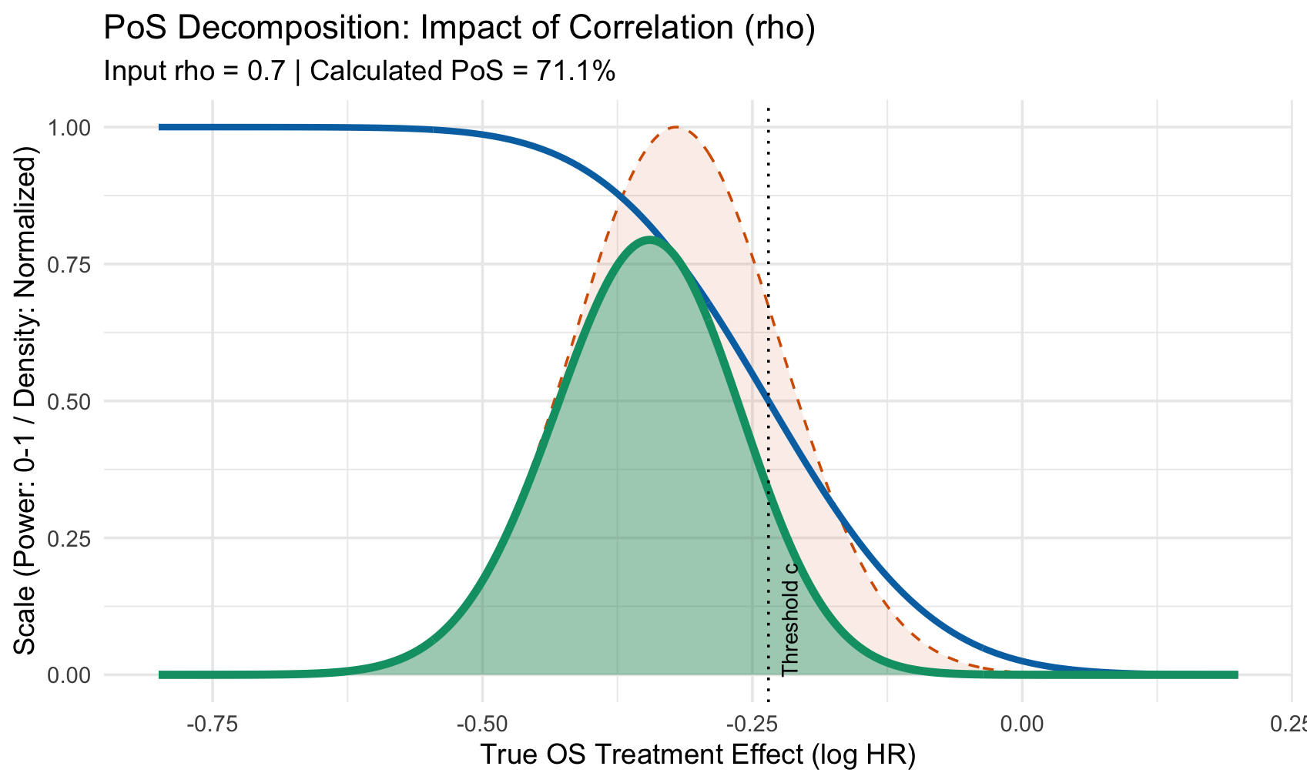
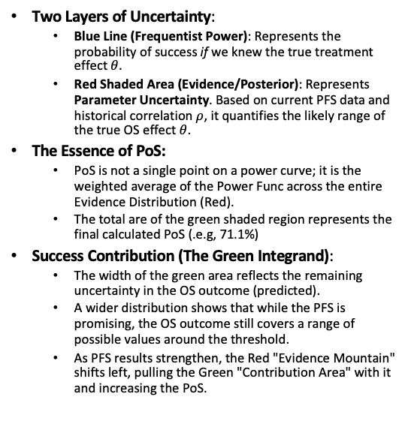
Mechanistic Decomposition of PoS- An Example
Two Layers of Uncertainty:
Blue Line (Frequentist Power): Represents the probability of success if we knew the true treatment effect $θ.$
Red Shaded Area (Evidence/Posterior): Represents Parameter Uncertainty. Based on current PFS data and historical correlation $ρ$, it quantifies the likely range of the true OS effect $θ$.
The Essence of PoS:
PoS is not a single point on a power curve; it is the weighted average of the Power Func across the entire Evidence Distribution (Red).
The total are of the green shaded region represents the final calculated PoS (.e.g, 71.1%)
Success Contribution (The Green Integrand):
The width of the green area reflects the remaining uncertainty in the OS outcome (predicted).
A wider distribution shows that while the PFS is promising, the OS outcome still covers a range of possible values around the threshold.
As PFS results strengthen, the Red "Evidence Mountain" shifts left, pulling the Green "Contribution Area" with it and increasing the PoS.

Slide 7

Equivalent view: posterior predictive distribution
An equivalent expression uses the posterior predictive distribution of the future result:
$$p\left(y^{∗}∣Y_{o}\right)=∫p\left(y^{∗}∣θ\right) p\left(θ∣Y_{o}\right) dθ.$$
Then PoS is simply:
$$\text{PoS}=Pr\left(Y^{∗}∈R∣Y_{o}\right)=∫1\left(y^{∗}∈R\right) p\left(y^{∗}∣Y_{o}\right) dy^{∗}.$$
This view is often convenient for computation and interpretation.

Slide 8

Linking the ICB surrogate scenario to PoS
In the ICB setting, PFS typically matures earlier than OS.
We use historical trials reporting both endpoints to learn the joint relationship:
$${\left(θ_{OS},θ_{PFS}\right)}^{⊤}∼MVN\left(μ,Σ_{\text{between}}\right),$$
and then update OS using the observed current-trial PFS result $y_{c}$.
This yields a predictive distribution for the final OS estimate:
$$Y_{OS}^{∗}∣y_{c}∼N​\left(m_{\text{post}}, v_{\text{post}}+σ_{∗}^{2}\right),$$
and PoS follows from the OS success rule:
$$\text{PoS}=Pr\left(Y_{OS}^{∗}<−1.96 σ_{∗}∣y_{c}\right).$$
$m_{\text{post}}$ = the best current guess of the true OS log(HR) after borrowing strength from PFS evidence.
$v_{\text{post}}$ = the remaining uncertainty about the true OS log(HR) after that update.

Slide 9
What we’re trying to answer
Scenario (ICB trial):
Primary endpoint: PFS (read out earlier)
Key secondary endpoint: OS (matures later)
Effect measure: log(HR) for both endpoints
Decision question:
Given the current trial’s observed PFS result, what is the probability that the final OS analysis will be statistically significant (two-sided p < 0.05) in the beneficial direction?
Notes:
This is the core “PoS” story: translate earlier evidence (PFS) into an actionable probability about OS success, while carrying uncertainty.

Slide 10

PoS in one line
Let:
$θ$ = the (unknown) true treatment effect (here: $θ=log\left(HR\right))$
$Y^{∗}$ = the future study’s estimator (e.g., estimated log(HR) at final OS analysis)
$R$ = the success region (defined by your decision rule)
Then predictive probability of success is:
$$\text{PoS} = ∫Pr\left(Y^{∗}∈R∣θ\right) π\left(θ∣\text{current} \text{evidence}\right) dθ$$
Interpretation: average the conditional “power” over uncertainty in the true effect.

Slide 11

Where “current evidence” comes from
We will combine two sources:
Historical trials (e.g., 27 ICB studies) that report both endpoints
$y_{i,OS}=log\left(HR_{OS,i}\right)$, $se_{i,OS}$
$y_{i,PFS}=log\left(HR_{PFS,i}\right)$, $se_{i,PFS}$
Current trial’s PFS (available now)
$y_{c}=log\left(HR_{PFS}\right)$, $se_{c}$
Goal: obtain $θ_{OS}^{∗}∣y_{c}$ (predictive distribution for the current trial’s true OS effect), then compute PoS.

Slide 12

Model (concept picture)
Two layers:
Between-study layer (true effects differ across trials):
$${\left(θ_{i,OS},θ_{i,PFS}\right)}^{⊤}∼\text{MVN}\left(μ, Σ_{between}\right)$$
Within-study layer (estimation error):
$${\left(y_{i,OS},y_{i,PFS}\right)}^{⊤}∼\text{MVN}\left({\left(θ_{i,OS},θ_{i,PFS}\right)}^{⊤}, Σ_{within,i}\right)$$
Key parameters:
$μ_{OS},μ_{PFS}$: average (logHR) effects across trials
$τ_{OS},τ_{PFS}$: between-study SDs (heterogeneity)
$ρ$: correlation between true OS and true PFS effects
Notes:
The whole approach rests on “exchangeability”: the historical trials and the current trial are assumed to come from the same super-population (up to heterogeneity).

Slide 13
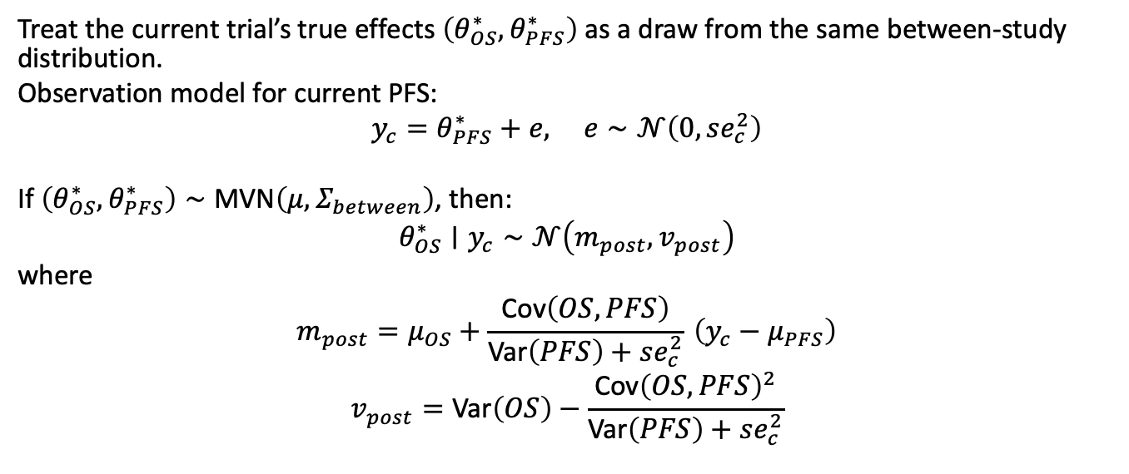
Conditioning: OS effect given observed PFS
Treat the current trial’s true effects $\left(θ_{OS}^{∗},θ_{PFS}^{∗}\right)$ as a draw from the same between-study distribution.
Observation model for current PFS:
$$y_{c}=θ_{PFS}^{∗}+e, e∼𝒩\left(0,se_{c}^{2}\right)$$
If $\left(θ_{OS}^{∗},θ_{PFS}^{∗}\right)∼\text{MVN}\left(μ,Σ_{between}\right)$, then:
$$θ_{OS}^{∗}∣y_{c}∼𝒩\left(m_{post},v_{post}\right)$$
where
$$m_{post}=μ_{OS}+\frac{\text{Cov}\left(OS,PFS\right)}{\text{Var}\left(PFS\right)+se_{c}^{2}} \left(y_{c}−μ_{PFS}\right)$$
$$v_{post}=\text{Var}\left(OS\right)−\frac{\text{Cov}{\left(OS,PFS\right)}^{2}}{\text{Var}\left(PFS\right)+se_{c}^{2}}$$
Notes:
The predictive engine is a Bayesian update under a bivariate normal model linking PFS and OS. The first quantity, 𝑚_"post" , is our posterior mean for the final OS effect on the log(HR) scale. We start from the historical OS baseline, then shift that prediction based on how the current PFS signal deviates from its historical expectation, scaled by the estimated between-study relationship. Practically, when PFS comes in stronger than expected, it nudges our OS forecast in the favorable direction; when PFS is weaker, the OS forecast is pulled back toward the baseline. The second quantity, 𝑣_"post" , is our remaining uncertainty after incorporating PFS. Bringing PFS into the model produces a variance reduction—more precise PFS evidence clears more of the fog around the OS forecast, while noisier PFS reduces uncertainty less. Overall, these two pieces ensure our PoS is not a reaction to a single interim signal, but a coherent, mathematically grounded forecast that combines current evidence with historically learned OS–PFS patterns and their uncertainty.

Slide 14

PoS in closed form
Final OS estimator:
$$Y_{OS}^{∗}∣y_{c}∼𝒩\left(m_{post}, v_{post}+se_{∗}^{2}\right)$$
Therefore:
$$\text{PoS}=Pr\left(Y_{OS}^{∗}<c∣y_{c}\right)=Φ​\left(\frac{c−m_{post}}{\sqrt{v_{post}+se_{∗}^{2}}}\right)$$
Knobs that matter:
$ρ$: stronger PFS–OS association → PFS updates OS more
$τ$’s: more heterogeneity → less certainty → PoS often down
$d_{events}$: more OS events → smaller $se_{∗}$ → PoS up
Notes:
This slide shows how we translate the current PFS signal $y_{c}$into a forecast for the final OS estimate. Under the bivariate normal update, the final OS estimator follows $Y_{OS}^{∗}∣y_{c}∼𝒩\left(m_{\text{post}} , v_{\text{post}}+se_{∗}^{2}\right)$, where $m_{\text{post}}$is the updated mean OS effect and $v_{\text{post}}+se_{∗}^{2}$is the total predictive uncertainty. PoS is then the probability of crossing the success threshold $c$: . Three knobs drive PoS: higher $ρ$makes PFS update OS more, larger $τ$increases uncertainty and often lowers PoS, and more OS events $d_{\text{events}}$reduces $se_{∗}$and typically raises PoS

Slide 15
Reproducible demo: simulate 27 historical ICB trials
We’ll create a virtual dataset with:
K = 27 historical trials
True bivariate relationship between log(HR_OS) and log(HR_PFS)
Realistic ranges of standard errors
Trial ID | Observed OS log(HR) | OS Std. Error (se) | Observed PFS log(HR) | PFS Std. Error (se)
1 | -0.531 | 0.108 | -0.654 | 0.133
2 | -0.044 | 0.138 | -0.693 | 0.104
3 | -0.227 | 0.140 | -0.297 | 0.114
4 | -0.387 | 0.183 | -0.460 | 0.124
5 | -0.224 | 0.137 | -0.422 | 0.120

Slide 16
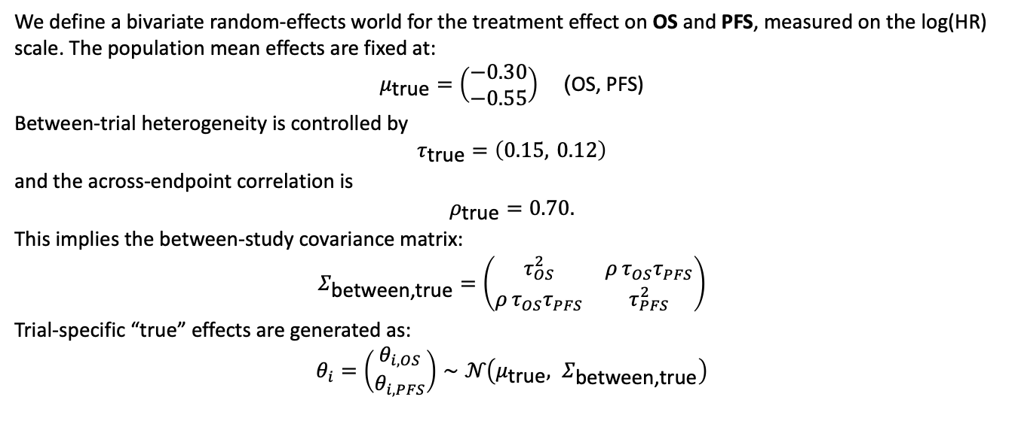
Simulation Setting: “True” Hyper-parameters
We define a bivariate random-effects world for the treatment effect on OS and PFS, measured on the log(HR) scale. The population mean effects are fixed at:
$$μ_{\text{true}}=\left(\begin{matrix}−0.30 \\ −0.55\end{matrix}\right) \text{(}\text{OS}\text{, }\text{PFS}\text{)}$$
Between-trial heterogeneity is controlled by
$$τ_{\text{true}}=\left(0.15, 0.12\right)$$
and the across-endpoint correlation is
$$ρ_{\text{true}}=0.70.$$
This implies the between-study covariance matrix:
$$Σ_{\text{between}\text{,}\text{true}}=\left(\begin{matrix}τ_{OS}^{2} & ρ τ_{OS}τ_{PFS} \\ ρ τ_{OS}τ_{PFS} & τ_{PFS}^{2}\end{matrix}\right)$$
Trial-specific “true” effects are generated as:
$$θ_{i}=\left(\begin{matrix}θ_{i,OS} \\ θ_{i,PFS}\end{matrix}\right)∼𝒩​\left(μ_{\text{true}}, Σ_{\text{between}\text{,}\text{true}}\right)$$

Slide 17
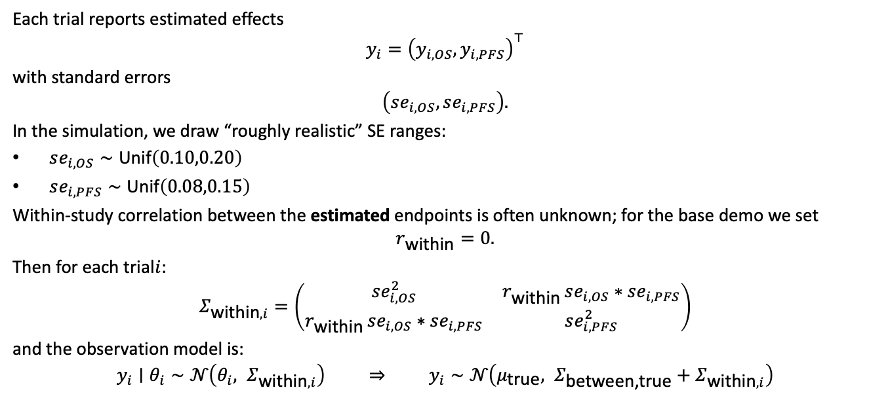
Observation model: within-study uncertainty (SE) and covariance
Each trial reports estimated effects
$$y_{i}={\left(y_{i,OS},y_{i,PFS}\right)}^{⊤}$$
with standard errors
$$\left(se_{i,OS},se_{i,PFS}\right).$$
In the simulation, we draw “roughly realistic” SE ranges:
$se_{i,OS}∼\text{Unif}\left(0.10,0.20\right)$
$se_{i,PFS}∼\text{Unif}\left(0.08,0.15\right)$
Within-study correlation between the estimated endpoints is often unknown; for the base demo we set
$$r_{\text{within}}=0.$$
Then for each trial$i$:
$$Σ_{\text{within},i}=\left(\begin{matrix}se_{i,OS}^{2} & r_{\text{within}} se_{i,OS}∗se_{i,PFS} \\ r_{\text{within}} se_{i,OS}∗se_{i,PFS} & se_{i,PFS}^{2}\end{matrix}\right)$$
and the observation model is:
$$y_{i}∣θ_{i}∼𝒩​\left(θ_{i}, Σ_{\text{within},i}\right) ⇒ y_{i}∼𝒩​\left(μ_{\text{true}}, Σ_{\text{between}\text{,}\text{true}}+Σ_{\text{within},i}\right)$$

Slide 18
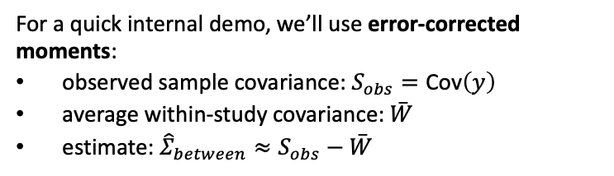
Estimate the between-study relationship (demo-friendly moment approach)
For a quick internal demo, we’ll use error-corrected moments:
observed sample covariance: $S_{obs}=\text{Cov}\left(y\right)$
average within-study covariance: $\overset{‾}{W}$
estimate: ${\hat{Σ}}_{between}≈S_{obs}−\overset{‾}{W}$
Parameter | Estimate | Interpretation (HR equivalent)
Mean OS Effect | -0.315 | Historical average $HR \approx 0.73$
Mean PFS Effect | -0.537 | Historical average $HR \approx 0.58$
OS Heterogeneity | 0.097 | Low-to-moderate cross-study variation
PFS Heterogeneity | 0.162 | Higher variability in PFS outcomes
Endpoint Correlation | 0.797 | Strong linkage between PFS and OS
Notes:
For production work you’d typically fit a full bivariate random-effects model (REML or Bayesian). This moment approach is intentionally simple for a clean demo.

Slide 19

Current trial: plug in observed PFS and compute PoS
Assume the current trial has interim/final PFS result:
$y_{c}=log\left(HR_{PFS}\right)$
$se_{c}$ (its standard error)
For OS final analysis, assume planned OS event count $d$. Under 1:1 allocation, Schoenfeld gives a useful approximation:
$$se_{∗}≈\frac{2}{\sqrt{d}}$$
Category | Parameter | Value
Observation | Observed PFS log(HR) | -0.600
 | Observed PFS Hazard Ratio | 0.549
OS Prediction | Predicted OS log(HR) Mean | -0.335
 | Predicted OS Hazard Ratio | 0.715
 | Prediction Uncertainty (SD) | 0.137
Success Criteria | Target OS Events | 278
 | Standard Error | 0.120
 | Success Threshold (log HR) | -0.235
Final Result | Probability of Success | 70.8%

Slide 20
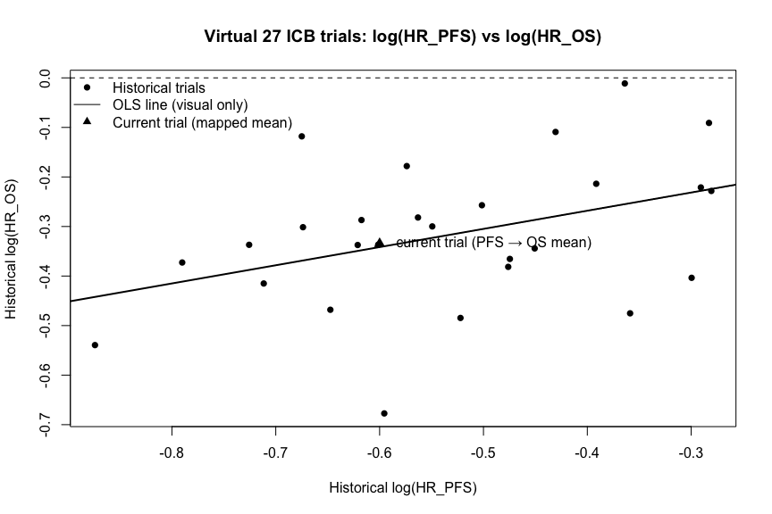
Visual 1: historical relationship (virtual 27 trials)

Slide 21
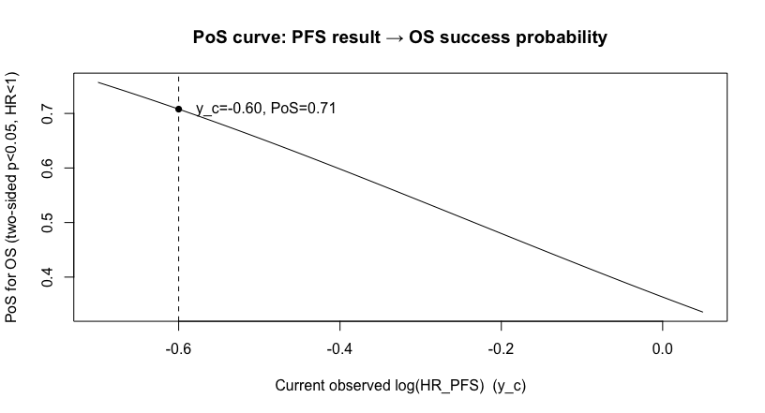
Visual 2: PoS curve (how PFS maps to OS success probability)
Notes:
This plot is what decision-makers usually want: a quantitative map from current PFS readout to probability of final OS success.

Slide 22
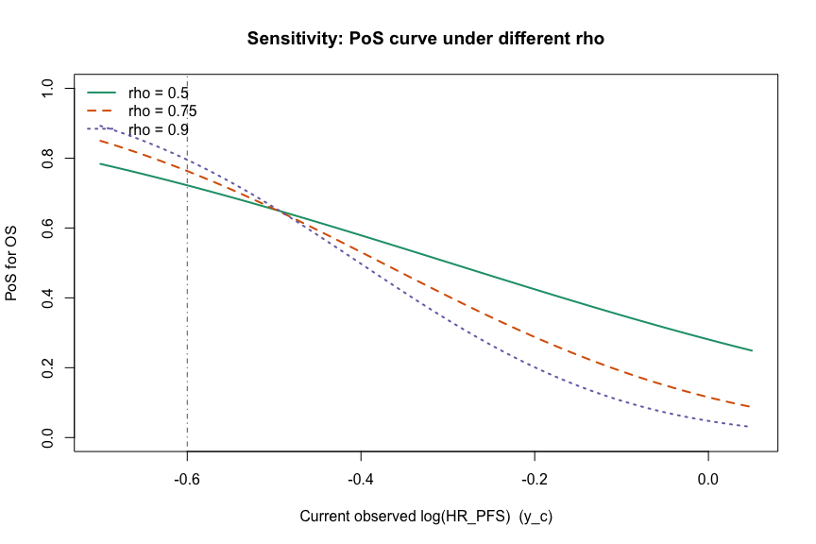

Sensitivity demo: vary PFS–OS correlation ($ρ$)

Slide 23

Sensitivity: The Power of Information (Event Count d)
If your event count changes, so does $se_{∗}$ and the success threshold $c$.
Target OS Events (d) | Std. Error (se∗) | Success Threshold (c) | Probability of Success (PoS)
150 | 0.163 | -0.320 | 50.1%
200 | 0.141 | -0.277 | 60.0%
240 | 0.129 | -0.253 | 66.3%
278 (Planned) | 0.120 | -0.235 | 71.1%
300 | 0.115 | -0.226 | 73.5%
400 | 0.100 | -0.196 | 81.6%

Slide 24

Takeaways
PoS answers a decision question: probability of meeting a success rule, not “best guess HR”.
In this ICB setup:
Historical trials estimate a between-study OS–PFS association ($ρ$, heterogeneity)
Current PFS readout updates the predicted true OS effect via conditional normal formulas
Final OS success probability is computed with a single Normal CDF.
Sensitivity analysis is not optional:
$ρ$ (association strength), heterogeneity ($τ$), and OS information (event count) are the main drivers.

Slide 25

Next steps (toward production)
If this moves beyond a virtual demo (full Bayesian path):
Full Bayesian = one coherent engine: estimate $μ,τ,ρ,r$ jointly and propagate all uncertainty into PoS and decision thresholds.
Treat within-study correlation $r$ as unknown → assign a prior (or run sensitivity) and let data update it, instead of fixing $r=0.$
Model drivers of the OS–PFS link (e.g., crossover, line of therapy, combo vs mono) as covariates or subgroup effects, so 𝜌 can adapt by design context.
Use it as a living interim engine: as PFS/OS mature, update the posterior and re-run PoS at each readout—same framework, new data.
Notes:
For an internal share, you can end with a clear checklist: what you need to collect from historical trials and what assumptions drive sensitivity.

Slide 26
Back Up slides

Slide 27
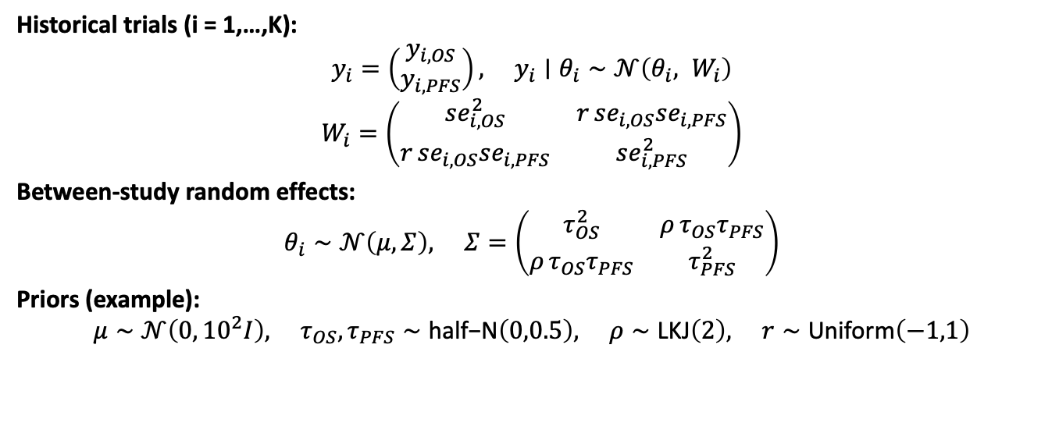
Full Bayesian PoS engine (ICB): model
Historical trials (i = 1,…,K):
$$y_{i}=\left(\begin{matrix}y_{i,OS} \\ y_{i,PFS}\end{matrix}\right), y_{i}∣θ_{i}∼𝒩\left(θ_{i}, W_{i}\right)$$
$$W_{i}=\left(\begin{matrix}se_{i,OS}^{2} & r se_{i,OS}se_{i,PFS} \\ r se_{i,OS}se_{i,PFS} & se_{i,PFS}^{2}\end{matrix}\right)$$
Between-study random effects:
$$θ_{i}∼𝒩\left(μ,Σ\right), Σ=\left(\begin{matrix}τ_{OS}^{2} & ρ τ_{OS}τ_{PFS} \\ ρ τ_{OS}τ_{PFS} & τ_{PFS}^{2}\end{matrix}\right)$$
Priors (example):
$$μ∼𝒩\left(0,{10}^{2}I\right), τ_{OS},τ_{PFS}∼\text{half}\text{−}\text{N}\left(0,0.5\right), ρ∼\text{LKJ}\left(2\right), r∼\text{Uniform}\left(−1,1\right)$$
Notes:
This slide defines the full Bayesian bivariate random-effects model learned from historical ICB trials. We can treat within-study correlation r as unknown (prior or sensitivity), and we carry uncertainty in (mu, tau, rho, r) forward rather than plugging in point estimates.

Slide 28
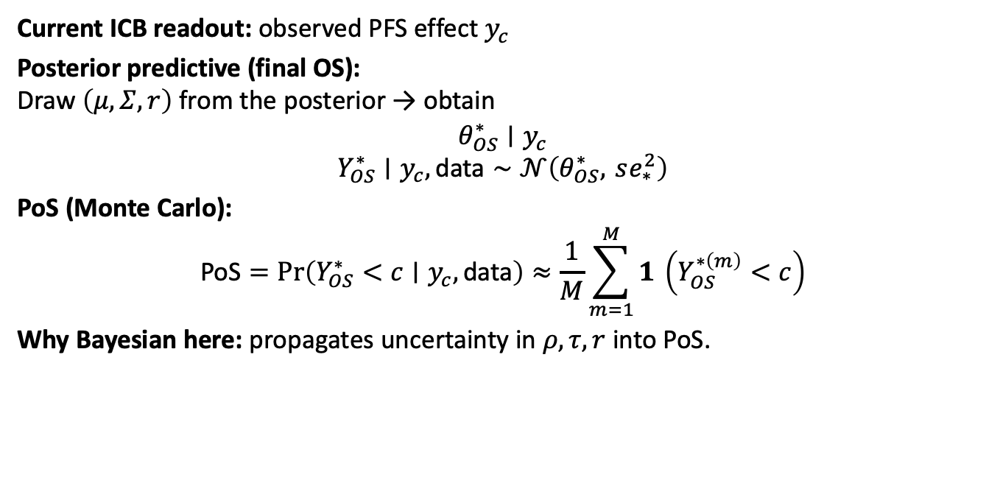
Full Bayesian PoS engine (ICB): PoS computation
Current ICB readout: observed PFS effect $y_{c}$
Posterior predictive (final OS): Draw$\left(μ,Σ,r\right)$ from the posterior → obtain
$$θ_{OS}^{∗}∣y_{c}$$
$$Y_{OS}^{∗}∣y_{c},\text{data}∼𝒩\left(θ_{OS}^{∗}, se_{∗}^{2}\right)$$
PoS (Monte Carlo):
$$\text{PoS}=Pr\left(Y_{OS}^{∗}<c∣y_{c},\text{data}\right)≈\frac{1}{M}\sum_{m=1}^{M}{1}​\left(Y_{OS}^{∗\left(m\right)}<c\right)$$
Why Bayesian here: propagates uncertainty in $ρ,τ,r$ into PoS.
Notes:
Given the current PFS signal yc, we sample the posterior predictive distribution of the final OS estimate. PoS is the fraction of posterior predictive draws that cross the OS success threshold c. This keeps the same PoS idea, but fully propagates uncertainty in rho, tau, and r.

